Slide 1

THE AGENT PORTABLE DATA ANALYSIS CONTAINER
Edouard Severing
Wageningen University and Research
12 FEB 2025

Slide 2
WP6 Portable Data Analysis Pipeline
The AGENT project is divided in several work packages
Within WP4, GWAS and Genomic prediction workflows have been developed
WP6 is tasked with making these workflows more general so that they can be applied to novel/different data.
In this presentation I will show you how the initial WP4 GWAS pipeline evolved to its current form within WP6.

Slide 3
GWAS pipelines
You might think another GWAS pipeline?
Aren’t there many already → Yes
And they mostly follow the same basic principle
What sets them apart are: User interface, types of output (aesthetics) , tools methods used. With other words, fine tuning to the needs of the scientist.
So the pipeline within presentation is tailored to needs within the AGENT project.
On a personal note, I am not big fan of automatizing analysis like GWAS.
Phenotype
Genotype data
Filtering/Pruning
Processing
Population Structure
PCA
GWAS

Slide 4

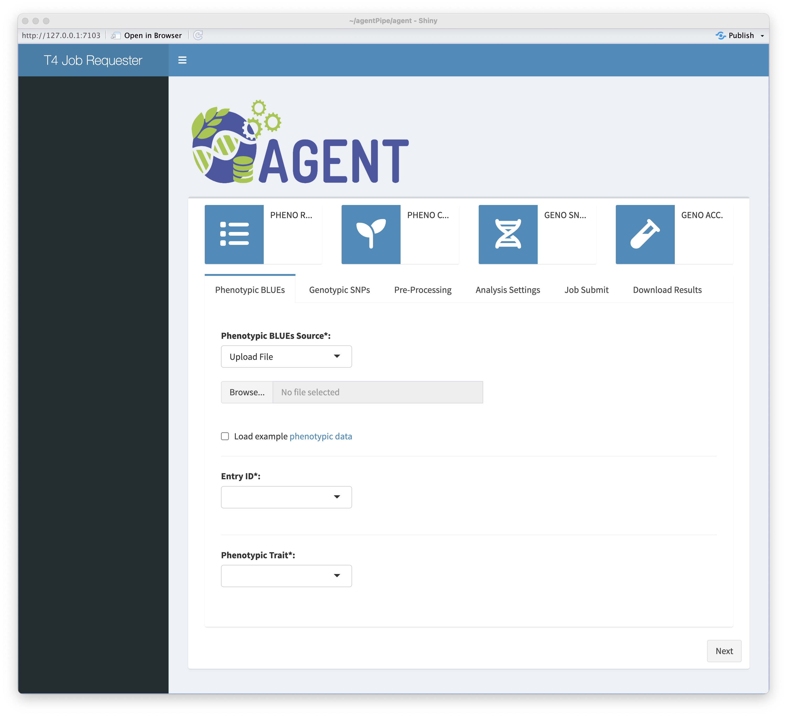

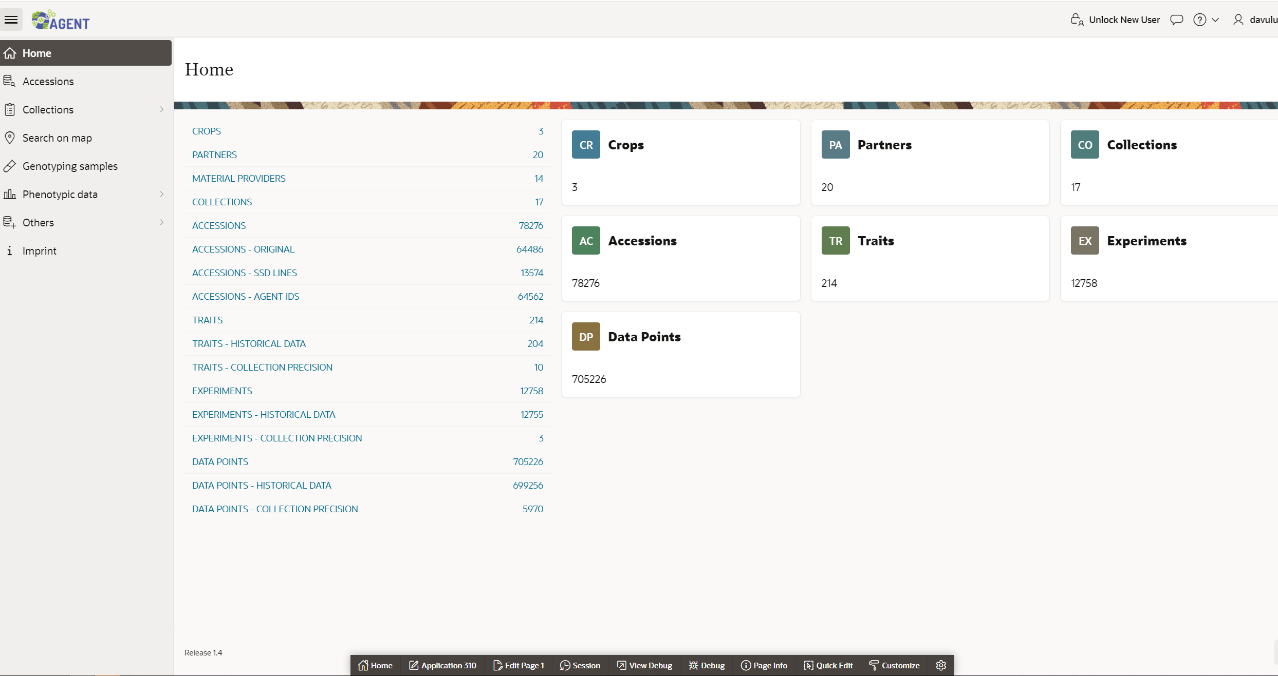


Generalizing the WP4 GWAS workflow
Detach & generalize
SNPs
Traits
Configuration
Dispatch package
R data object
R – based GWAS (Back-end)
Output
GUI (Front-end)
Input and configuration
Shiny App
Select Genotype input
Select trait input
Configure analysis
AGENT portal
Command line

Slide 5

Containerization
Dependencies
R executable
GAPIT
ASRgenomic
SNPs
Traits
Configuration
Dispatch package
R data object
Output
R – based GWAS/G-pred
Pipeline
Package the pipeline + dependencies into a container
Done and tested

Slide 6





Does singularity containerization mean deployable everywhere?
Singularity depends on Linux specific functionality
Virtual machine running Linux
Should work on Intel and apple silicon CHIPS
Technically running Linux under windows

Slide 7
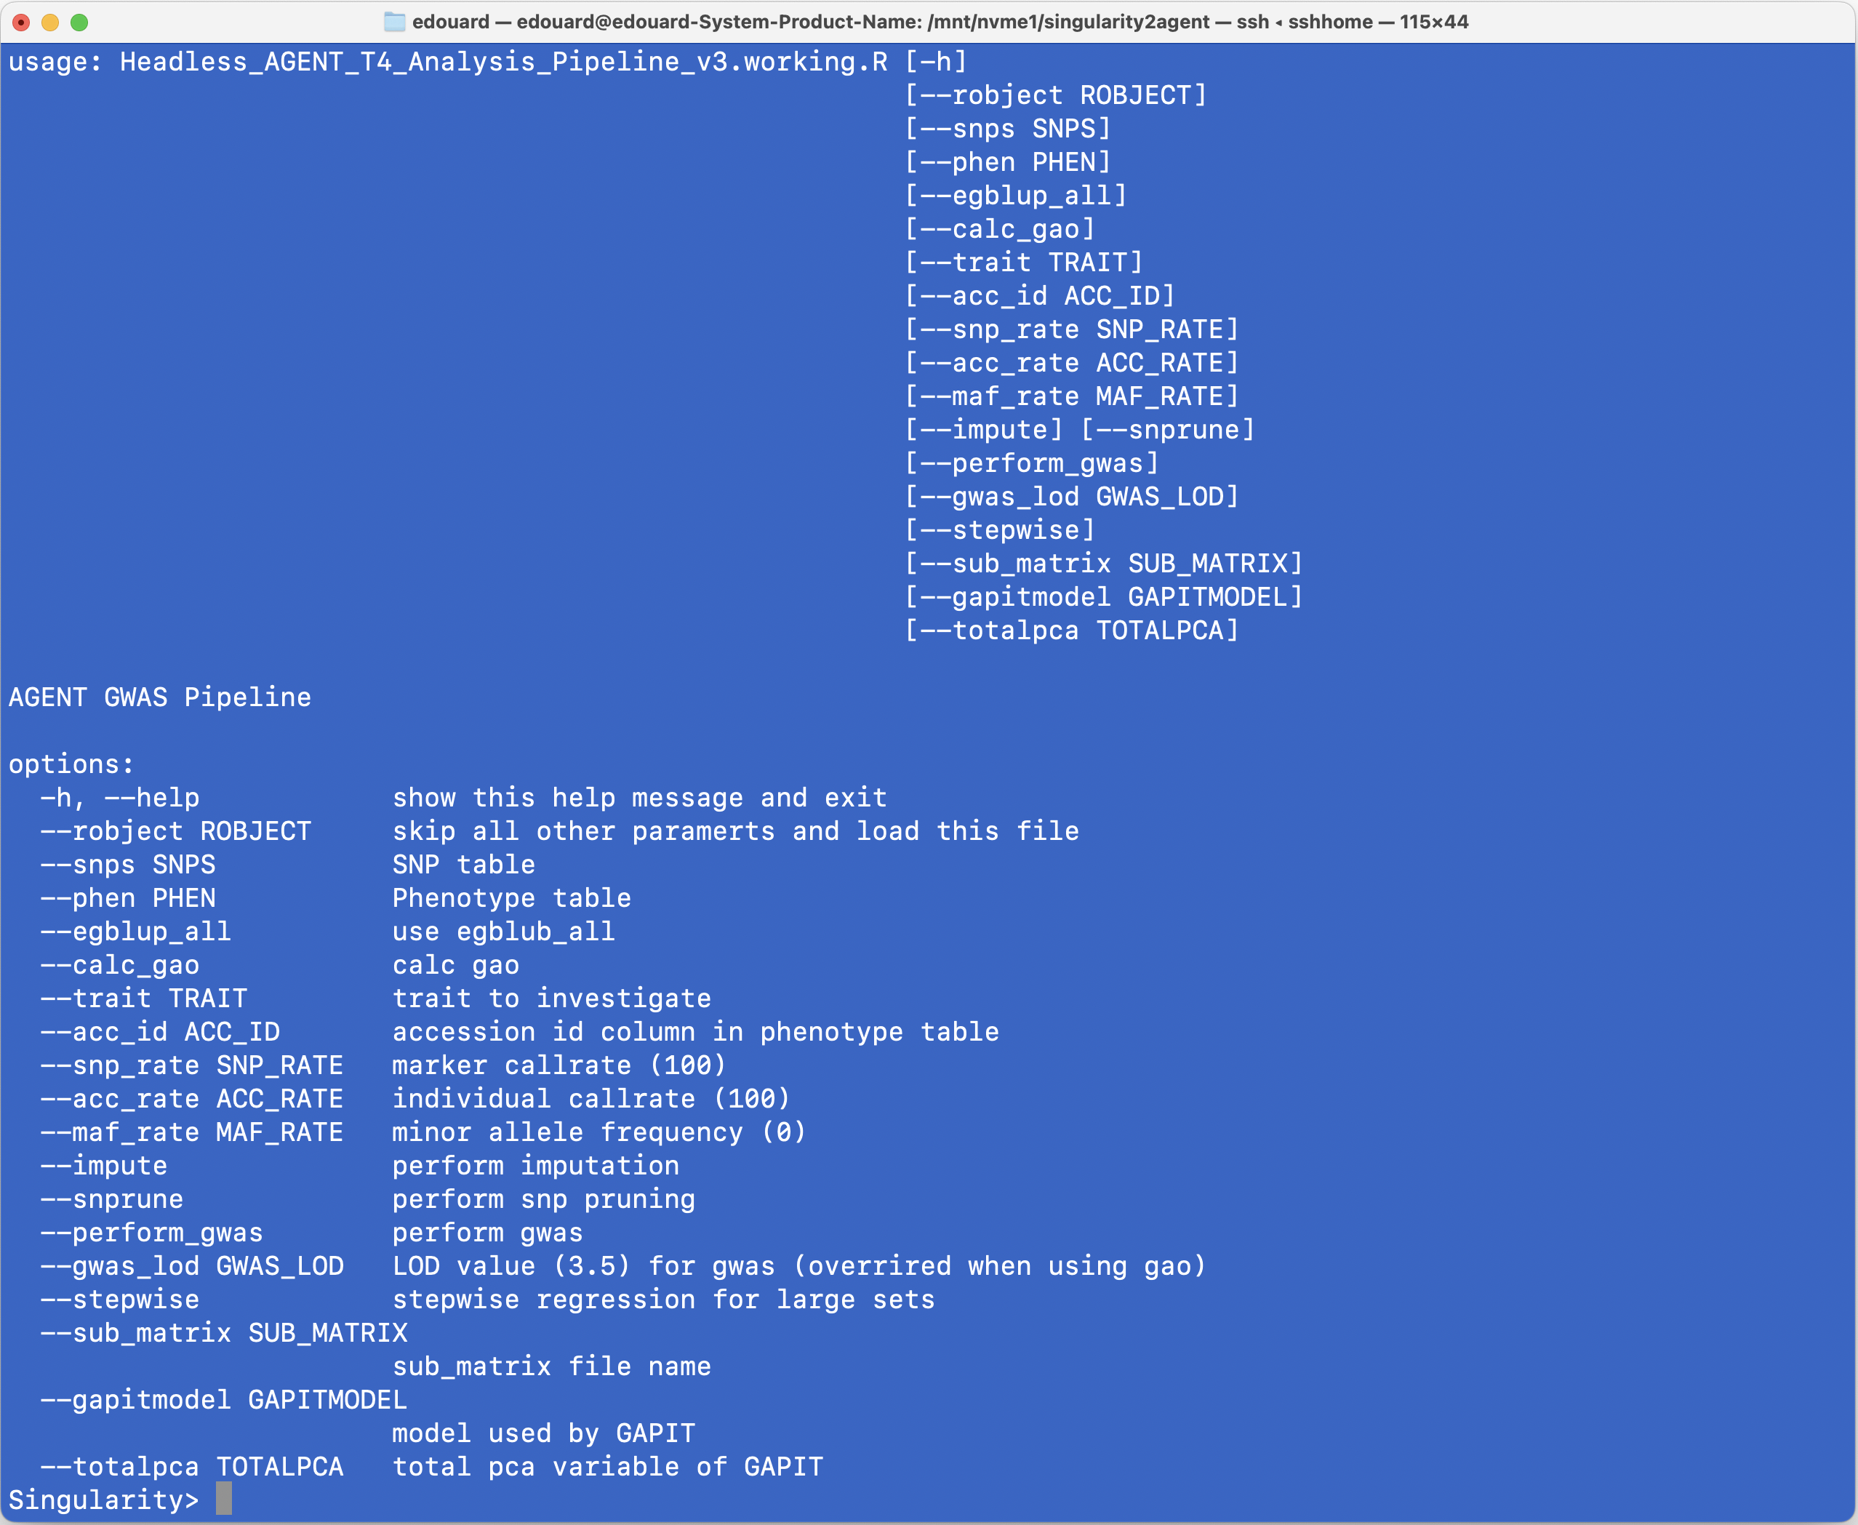
Last version of the container
GUI input should still work
Command line interface
R – based GWAS/G-pred
Pipeline
SNPs
Traits
Headless (no interface)
Configuration
Dispatch package
R data object
SNP-file
Traits file
parameters

Slide 8

Testing with Lettuce data
Initial test set that worked:
2870 Individuals with 46272 markers
HapMap format
The Lettuce data set:
440 Individuals with 12983735 markers
VCF
Converted to hapmap format
Resistance to Bremia Lactuca
Current pipeline
Previous WP5/WP6 pipeline
SNP hapmap format
SNP hapmap format
SNP VCF format
Whole Data into memory
Whole Data into memory
Cause (24GB)
Data filtering call rate/MAF (PLINK)
PLINK is built for large genotype sets
Data filtering call rate/MAF
Data filtering call rate/MAF/impute
Killed at this step
LD pruning (PLINK)
LD pruning (SNprune)
LD pruning (SNprune)
GWAS (BLINK)
GWAS (GAPIT)
GWAS (GAPIT)
128GB RAM available
Successful
<10GB RAM

Slide 9
Data flow
Old pipeline
New pipeline
In the end we get results
SNP VCF format
12983735 (100%)
Whole Data into memory
5G
Data filtering call rate/MAF (PLINK)
12812089 (98.7%)
/imData filtering call rate/MAF
LD pruning (PLINK)
3036817 (23.4%)
LD pruning (SNprune)
SNP hapmap format
X
GAO
256.4GB
request
GWAS (GAPIT)
X another Memory issue to look at

Slide 10
Lets start from
0
necessary from scratch
Keep the original idea of the WP4 pipeline as far as possible
Enhance memory performance:
Try to integrate the old WP6 pipeline
Also check if there is an R only solution but with better memory management
Build the pipeline using a big-data example
add features that I normally would use to ensure quality of the analysis (incl. plots etc)
Build the pipeline such that we can add a command line interface to make it fully stand alone.
Assess if it is necessary to containerize.

Slide 11
GWAS pipeline Input
Genotype data (Required)
SNP calls for now in VCF format
For testing we WGS data from 440 Lettuce accessions (~12,983,735)
Phenotype data (Required)
For now only in tab-separated file format with header!
Here we use flowering time from a precision collection sheet that CGN had available
Mapping (Optional)
Consider this to be like a passport file in tab-separated format with header!
I will show its use in a few slides.
For illustration we extracted species information from the Passport data
I wasn’t able to retrieve these data from BraPi end-points yet, but that will be possible in the Future:
Saves headaches, especially with mismatching identifiers

Slide 12
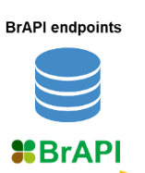






A final note on the input for the pipeline
Existing WP5/WP6 container
New container (IDEAL)
Download scripts
A/T C/T
A/A C/C
G/G T/T
A/T C/T
A/A C/C
G/G T/T
Phenotype/
Passport data
Genotype
Phenotype/
Passport data
Matching IDs is problem
Genotype

Slide 13
Managing huge genotypic data sets in R on computers with modest resources
Challenge: How to process huge genotypic data sets in R without overloading the memory.
Solution: Prevent importing the full genotype matrix into memory for as long as possible
Solution I
Solution II
In R processing using
GDS file format
SNPrelate, SeqArray
External Processing
(PLINK 1.9)
Bed format
Pros:
No external software needed
Relatively fast
Memory efficient
Works on Linux,Windows,Mac
Cons:
GDS file construction slow!
Repeated stuck file-handles
More tricky to implement
Pros:
Relatively fast
Memory efficient
Bed file creation is fast
No re-calculations*
Works on Linux,Windows,Mac
Cons:
External non-R software needed

Slide 14
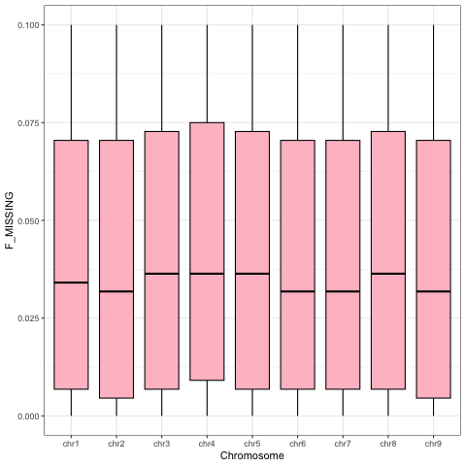
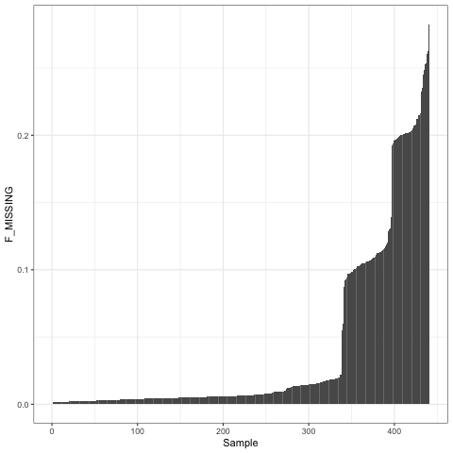
Genotype Quality control/Diagnostics (I)
I1 I2 I3
SNP1 AA AA ..
SNP2 TT .. ..
SNP3 .. CG GG
SNP4 .. TG TT
SNP5 .. TC CC
SNP6 TA TA AA
SNP7 CT TT ..
………
Per marker
Seem like groups
Per marker
Separate calls for GDS and Plink

Slide 15
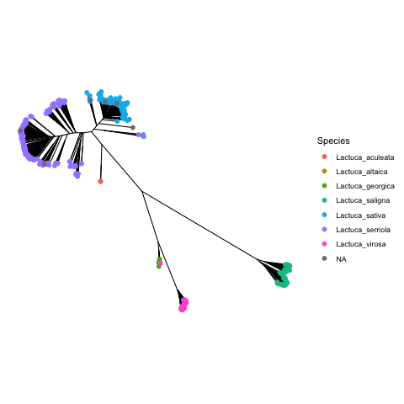
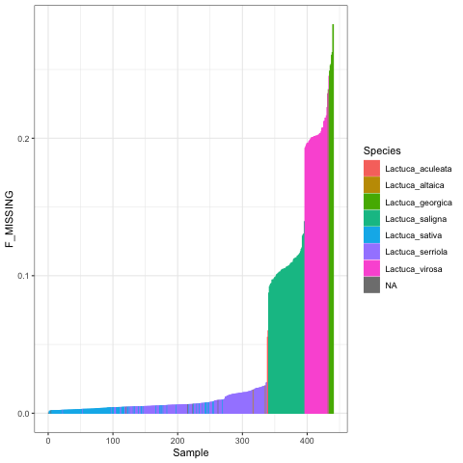
Diagnostics (II) using the mapping (passport info)
Mapping info can be used to see if there are patterns in the data. In this case we will use species info
Missing rates are not
random
Same barplot but with species colors
An Identity by state based neighbor joining tree. Explains the observed missing pattern
One of the reasons why scientist advocate for pan-genomes
I will probably add a box plot option with statistical test

Slide 16

CHECK POINT (I)
In Traffic: Be free to neglect me at your own risk …
In this pipeline: Please check the results until here and change parameters if necessary. I promise you that nothing will recalculated unless strictly necessary. (Especially important for the GDS file creation).
So far so good.

Slide 17
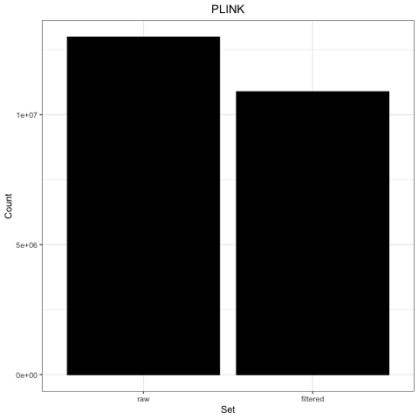
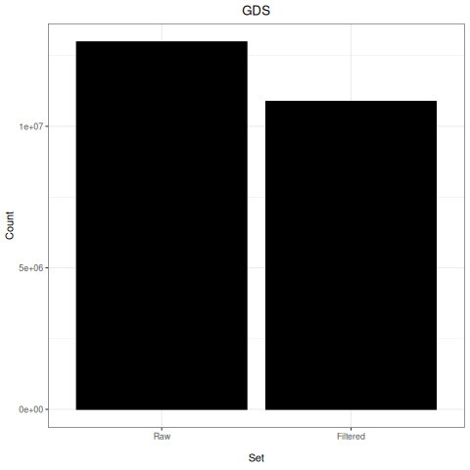
Filtering of raw VCF files
Filtering:
Missing calls at the marker level
Individuals with too many missing calls
Minor allele frequency
At this stage, the PLINK-based and GDS functions are not the same
PLINK: Filtering on all tree parameters can be done in a single command. New files created
GDS: Three different calls on on the original matrix. Filters are placed on top (no new files)
I got them to filter the same:
MAF 0.05
Missing per marker 0.1
Missing per individual 0.2

Slide 18
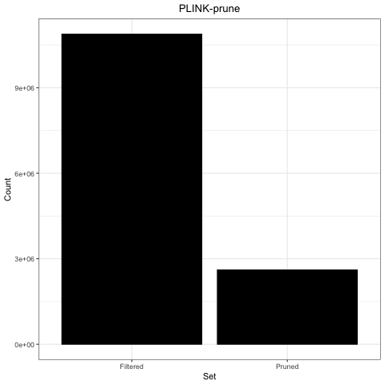
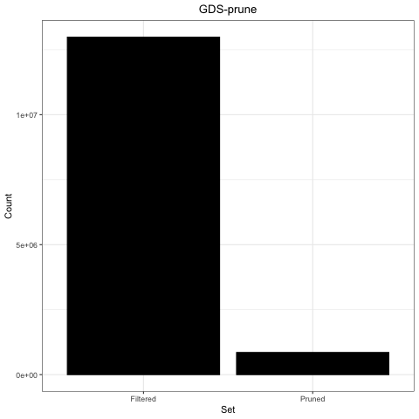
LD Pruning
Reducing the data sets by Linkage Disequilibrium pruning.
For LD pruning the same philosophy as for the SNP filtering applies
PLINK: new files are created
GDS: Technically a filter is placed on top
I need to play with the defaults

Slide 19
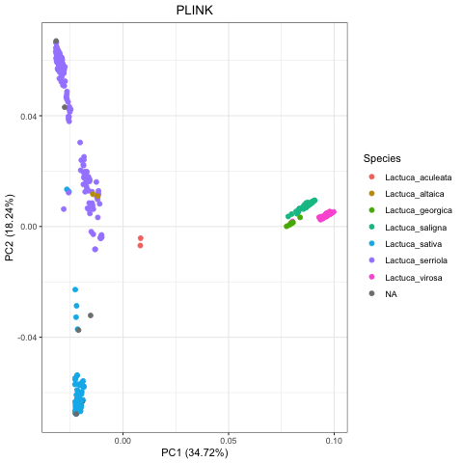
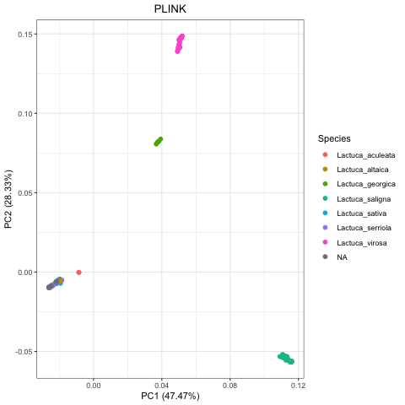
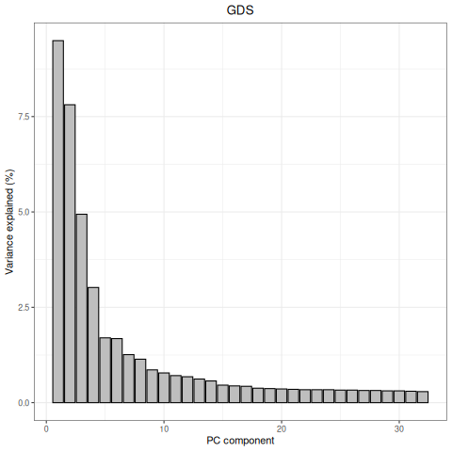
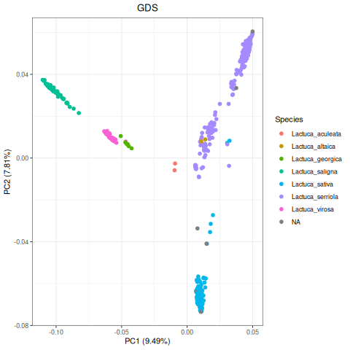
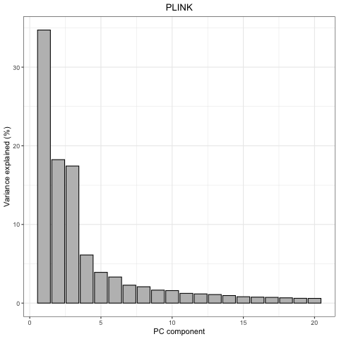
Population structure (PCA) using species names for coloring
The PCA plots constructed after pruning with the default PLINK is quite different from the one constructed after pruning using snpRelate
PLIINK
GDS/snprelate
Low variance explained
Raw SNP set
Looks more like the original publication
Wei et al. 2021

Slide 20
CHECK POINT (II)
Rember the message last time. Also here is a good point to go back and think
At this point I seriously started to doubt whether to continue using GDS in the pipeline because:
Odd results with the PCA after pruning.
More importantly, I work on the GDS with 2 packages SeqArray and snpRelate and they don’t seem to like working together a lot

Slide 21
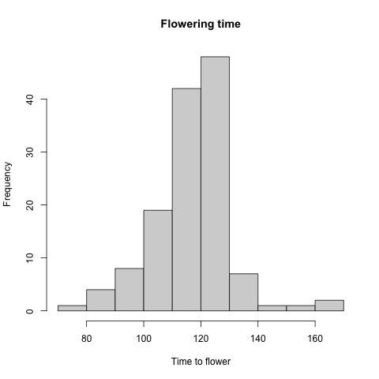
Now to the GWAS
Flowering time
After filtering and Pruning
3,117,719 SNPs

Slide 22
Test GWAS using emmax
In the original paper corresponding to the lettuce data, EMMAX was used for the GWAS analysis.
EMMAX comes as a stand-alone program so it is a good test to see how well this fits in the pipeline with big data.
Another genotype format needed.
Plink
Format
Transposed
Format
EMMAX
This is still ok qua speed
+ additional info
Custom C++ script
GDS
Format
012
+ GM
Format
CANCELED
ULTRA SLOW

Slide 23
What else is needed for EMMAX
Phenotypes
PCA components
Genotype
EMMAX-KIN
Extract top N
Ordering the samples
Phenotype data
Ordered
Co variates
Kinship matrix

Slide 24
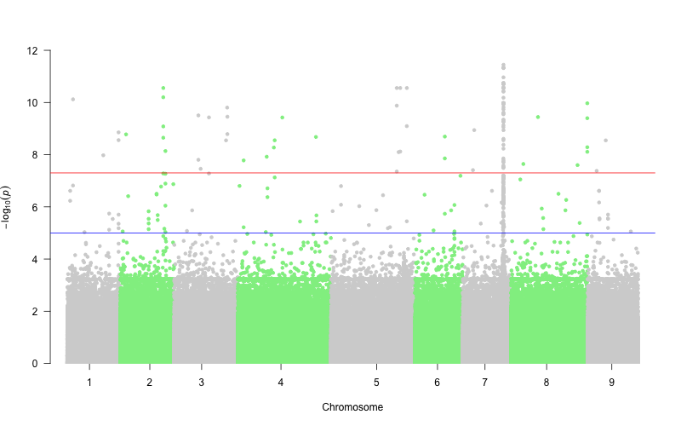
It worked
I already knew I had to get a huge peak on chromosome 7. This was just a confirmation that the data has the info.
A nice addition to pipeline to be able to run EMMAX

Slide 25
GAPIT3
The initial WP4 pipeline integrates GAPIT3 (with MLM model)
Our next move was to integrate this procedure and make it work.
For this we need to convert the data to a format that GAPIT3 can import.
Hapmap
Format
GAPIT3
I will make a direct
script to directly convert
Accepts the same data
+ additional info
Custom C++ script
Plink
Format
PLINK
012
+ GM
Format
GAPIT3
Missing data
Problemenatic
Attempt one

Slide 26
Too much memory use and taking forever
Total memory usage when I stopped > 60% of my 128 GB RAM
Critical points of memory increase:
Loading of the genotype matrix
Converting to numerical format
PCA
Kinship matrix
There used to be an option to provide the genotype file in fragments but that option is gone.

Slide 27
Solution
HAPMAP File
Phenotype data
Ordered
Kinship matrix
Co variates
File 1
….
GAPIT
Run one by one
File 9
Output 1 …. 9
Merge
FINAL OUTPUT

Slide 28
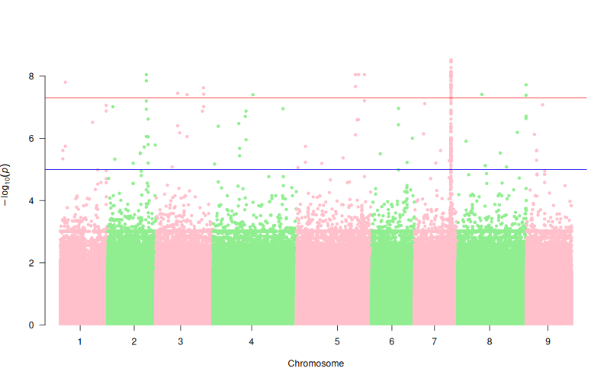
It worked
The splitting of the genotype file and usage of pre-calculated Kinship matrix, PCA did the trick
Max mem ~ 12% that I could notice
Reasonably fast but EMMAX is still way faster
GAPIT
EMMAX
(Nearly) exact same overall pattern just different scale

Slide 29
How to use
Command line interface
Manage parameters
R and command line
mainScript R
With parameters
This should be able to run in R.
R and command line
Filtering PLINK
Pruning with plink
Command line only WSL
Plotting the PCA with mapping info
EMMAX/GAPITS calls
Are implemented as separate functions
You can use them independent of the main flow
Personally I would stick to this

Slide 30
What did we end up with
A draft pipeline:
That has all my initial memory worries resolved
Still kept original flow of the WP4 pipeline
Has additional features (File formatting, diagnostic plots).
Easily extendable
What needs to be mentioned
I have not found a satisfactory way to make the pipeline completely R only and efficient at this point in time.
I have to add the CLI and clean the code a bit
I expect it to be ready in max a week.
Links will be shared through EURISCO.
I want to still check how to share. GITHUB, Zenodo or Biocontainers.
Anything sooner I can be contacted through edouard.severing@wur.nl

Slide 31
What about containerization (I)
Is it still a good idea? Absolutely!
During the setup, I came across many dependencies that needed to be installed.
GAPIT is not too straight forward to install. It even requires a package which has been removed from CRAN. LDHeatmap
Other packages required me to install system wide libraries
External software:
EMMAX
Some C++ code I wrote myself had issues compiling on the MAC but recoding worked
Containerization is still a good option to keep all that is needed together

Slide 32


What about containerization platform (II)
I am strongly thinking of containerizing the new pipeline in Docker rather than singularity as Docker appears to be more powerful. At least I have the impression.
I am actively investigating this.

Slide 33
Thanks for your attention!
WP4 and WP5/6 teams

